Slide 1
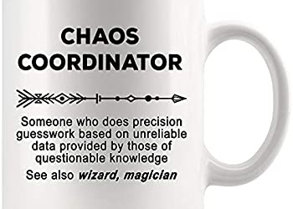
Kick Mechanics

Slide 2
Definition
Free Kick- A free kick is any kick which puts the ball in play to start a free kick down. A free kick is used for a kickoff , for a kick following a safety, and is used if a free kick is chosen following a fair catch or awarded fair catch. Rule 2.25.3
Scrimmage Kick- A scrimmage kick is any kick from in or behind the neutral zone during a scrimmage down. Either a place kick, punt, or drop kick may be used. Rule 2.25.4

Slide 3
Tips for Kicks
Move slowly and move to improve your position
Officiate ahead of the ball carrier
Off ball officials, clean up on the back side
Start with heals on the back of the white
Officiate behind the play
Expect the unexpected
Blocks must be perfect

Slide 4
Free Kick Positioning
Referee
Position on R’s goal line on the HL side between the center of the field and hash marks
Count R and make sure kicking team is legal.
Give the ready for play signal after all officials are ready
Signal game clock to start when touched by R and pick up runner until releasing to other officials
Rule on touchback and if momentum took the player into the end zone which should be marked with a bean bag.
Move cautiously with play and observe other players in vicinity of runner. Clean up behind runner.

Slide 5
Free Kick Positioning
Umpire
Position on R’s 20 yard line outside sideline opposite HL on press box side about a yard off the green so you can observe your sideline and maintain it.
Count R
Signal game clock to start when kick is legally touched by R on your side.
Pick up runner, but observe players and blocking in your area
Sound whistle, kill clock When ball becomes dead in your area
Observe dead ball activity

Slide 6
Free Kick Positioning
Head Linesman
Position on R’s 30 yard line the same yard line as the line-to-gain indicator about a yard off the field in the white so you can observe your sideline and maintain it.
Count R
Signal game clock to start when kick is legally touched by R on your side
Pick up runner, but observe players and blocking in your area
Sound whistle, kill clock When ball becomes dead in your area
Observe dead ball activity

Slide 7
Free Kick positioning
Line Judge
Position: R’s free-kick line, outside sideline opposite head linesman about a yard off the field in the white so you can observe and maintain your sideline
Temporarily move to 9-yard marks, then count K players and identify the free-kick line for the receiving team
Watch for any infractions involving R’s free-kick line and be alert for first touching by K mark with bean bag
After ball has gone downfield and after all players have cleared your free-kick line, move deliberately along sideline in that direction while watching for fouls away from ball. Cover 15 yards down sideline.
If ball becomes dead in your area, sound whistle and give time-out signal. Observe action of other players in vicinity of runner

Slide 8
Free Kick Positioning
Back Judge
-Take charge of the ball and position on K’s free kick line outside sideline to monitor bench area.
Move onto the field, hand the kicker the ball, instruct the kicker to wait for referee signal before kicking. If kicker not ready, place ball on ground next to tee.
-Watch for in fractions involving K’s free kick line and if foul on free kick give final signal and administer penalty.
Be alert for first touching on K, mark with bean bag.
After ball goes downfield and all K players pass the free kick line, move to the center of the field no more than 10-15 yards while maintaining coverage. You are responsible for K’s goal line.

Slide 9
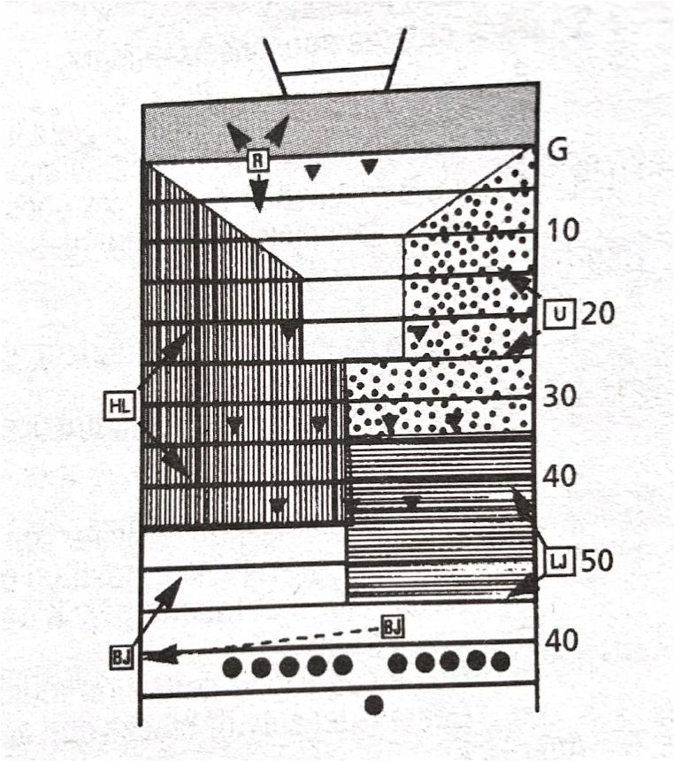

Slide 10
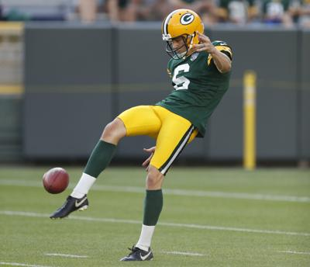
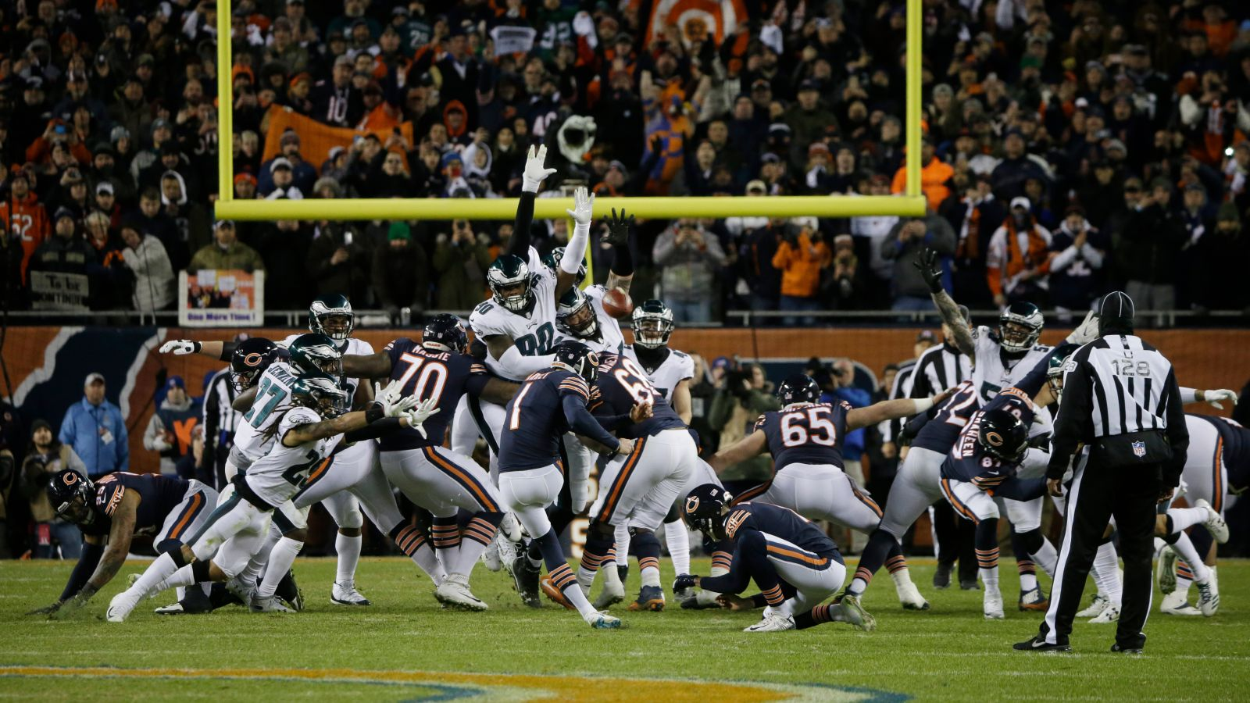
Scrimmage Kicks Rule 6-2

Slide 11
Scrimmage Kick (Punt)
      Referee
      Check down and distance with head linesman.
      Declare ball ready-for-play by using established procedure.
      Position: 3-5 yards outside the tight end and 2-3 yards behind the kicker, on kicking-leg side.
      Be able to see ball and observe all backs.
      Count K players and indicate to umpire that you have counted the
      kicking team.
      Signal to crew that K is in scrimmage-kick formation.

Slide 12
Scrimmage Kick (Punt)
  Umpire
Position: 10 yards deep keeping snap in view.
Count K players and indicate to referee that you have counted the kicking team.
Check numbering exception.
Key offensive guards and center.
Following kick, pivot to view line-judge side of field to observe blocks inside zone and move toward return area observing players away from ball

Slide 13
Scrimmage Kick (Punt)
HEAD LINESMAN AND LINE JUDGE
Position: Same as for run or pass.
Check down number, count R players and indicate to back judge that you have counted the receiving team.
. Head Linesman: Hold momentarily after snap. Know if ball crossed neutral zone, then move slowly downfield covering your side between neutral zone and deep receiver(s).
Line judge: Release on snap, move downfield covering your side between neutral zone and deep receiver(s).
Cover all kicks Sound whistle and give time-out signal (S #3) twice. If ball is kicked OOB, move farther downfield than where it went out. Walk upfield until referee spots you on sideline to your side.

Slide 14
Scrimmage Kick (Punt)
Back Judge
Position: 10-12 yards wider than and 2-3 yards behind the deepest receiver on head linesman’s side of field.
Count R players and indicate to wing officials that you have counted the receiving team.
Carry contrasting bean bags in hand during down to mark first touching, fumble, momentum or end of kick
When kick is short to either sideline Head linesman or line judge will assume responsibility for ball.
Cover long or deep kick out of bounds on head linesman’s side.
Cover all kicks down middle and be ready to rule on whether kick is touched by either team.
When kick becomes dead, sound whistle immediately and give time-out signal (S #3) twice
Move with runner who catches kick and advances. Other game officials will ordinarily pick up runner near line of scrimmage
If kick is caught inside 5-yard line and player is downed in his/her end zone or ball goes out-of-bounds there, be prepared to rule on whether his/her momentum took him/her into end zone

Slide 15
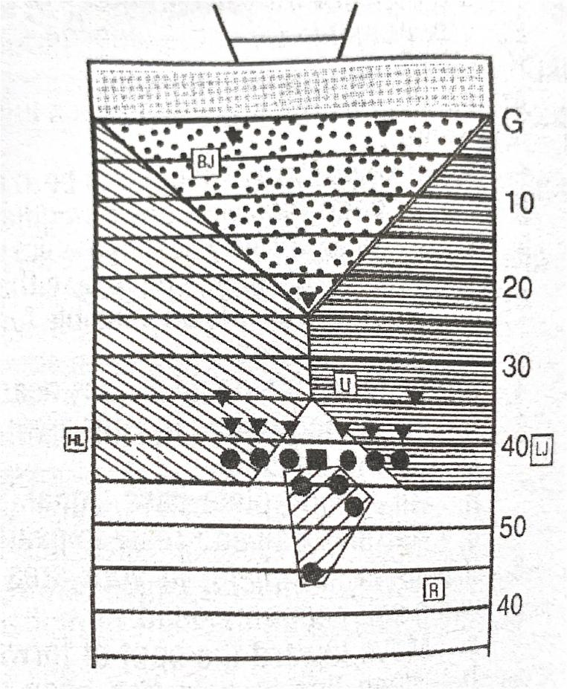

Slide 16
Scrimmage Kick (Field Goal/Try)
REFEREE
After ball is spotted: Position: 2-3 yards to rear and 3-5 yards to side of potential kicker, facing holder and able to see holder receive ball.
Count K players and indicate to umpire that you have counted the kicking team.
Signal to crew that K is in a scrimmage-kick formation.
Observe kicker, holder and opposite side tackle.
UMPIRE
After ball is spotted: Position: 4 to 7 yards deep keeping ball in view.
Count K players and indicate to referee that you have counted the kicking team.
Check for use of numbering exception.

Slide 17
Scrimmage Kick (Field Goal/Try)
HEAD LINESMAN OR LINE JUDGE
(whoever is looking at the back of the holder)
After ball is spotted: Position: on line of scrimmage on sideline.
Check down number, count R players and indicate to back judge that you have counted the receiving team.
Observe neutral zone.
Quickly move to goal line if run develops to referee’s side.
BACK JUDGE AND HEAD LINESMAN OR LINE JUDGE
(whoever is looking at the front of the holder)
After ball is spotted: Positions: Beyond end zone and behind your upright where you feel most comfortable and have best coverage of upright.
Count R players.
Back judge time 25-second count.

Slide 18
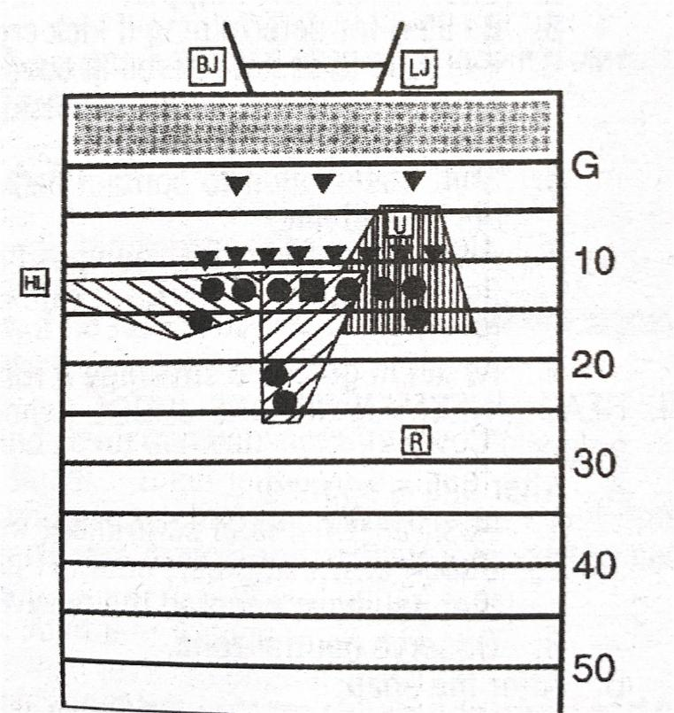

Slide 19
Who Sounds the Whistle on a…
1. Field Goal
2. 1pt Try

